Slide 1
Topic 1 slides Ask Weber
Weber Liu

Slide 2
Purpose of ask weber
To help you understand what is assessable
To help you understand the content better
To give you a safe space to ask questions (no matter how basic you think they are)
In fact, I’ll be asking you stupid questions if you don’t ask me any!
I’m here to support you and make your learning easier!

Slide 3
Random trivia
What type of cell makes up the longest cell in your body?
Where is this cell located
What is the shape of a red blood cell (RBC)?
Why is it shaped this way?

Slide 4
Learning objectives
Describe the main compartments of the body, inside-vs-outside, dorsal versus ventral, major body fluid, layers of organisational scale, dimensionality, complexity, dynamic nature of systems, and systems operating together
Explain the major themes organising the human body including scale, concept of surface area to volume ratio and examples of it in operation in the human body including the lungs, digestive tract

Slide 5
Topic 1
Cell diversity

Slide 6
Cell Theory
What are the three parts to Theodor Schwann’s cell theory?
Organisms <- cells
Cells = basic units of life
Cells <- other cells

Slide 7
Cell Theory
What are the two major classes of cells?
Prokaryotes
‘single celled organism’
Weird looking things that live on their own
Eukaryotes
‘multicellular organism’
Typically more complex (which needs more organization)

Slide 8
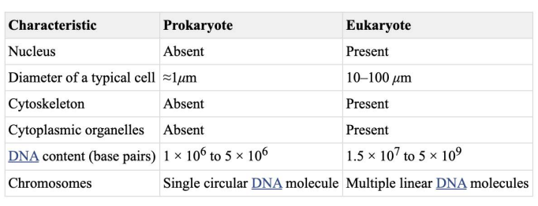

Slide 9
Name 5 types of tissues
Epithelial tissue
Connective tissue
Muscle tissue
Nervous tissue
Adipose tissue

Slide 10
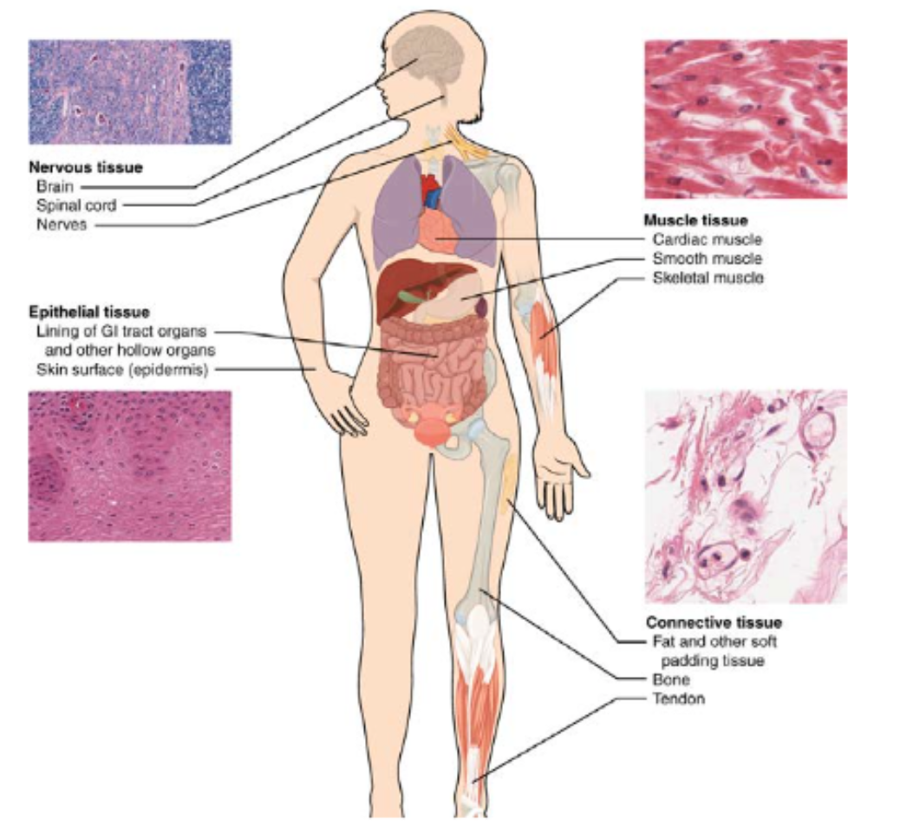
Lecture 1: Types of tissues
Identify the three types of muscle tissue
What muscle tissues are under ‘voluntary’ control
What muscle tissues are under ‘involuntary’ control
What is responsible for ‘involuntary’ control of muscles?
This type of cell lines the GIT as well as the skin. What type of tissue is this?
What is the name of the cell type that lines the inside of your blood vessels?
Blood vessels can contract and relax – this is called vasocontraction and vasoconstriction. What does that imply about the cell-type composition of blood vessels?

Slide 11
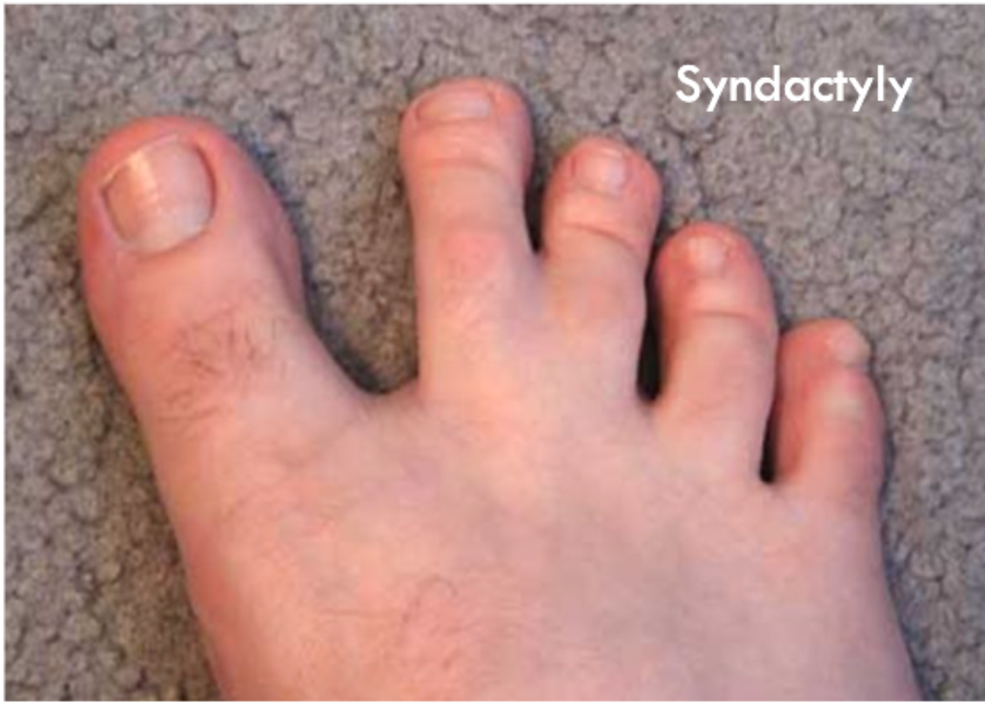
Lecture 1 - Apoptosis
In the figure to the left, the child has Syndactyly - the fusion of digits. In fact, when we are all developing in our mother’s wombs, our toes are all joined and webbed together. Explain what apoptosis is and how this sign relates to apoptosis.

Slide 12
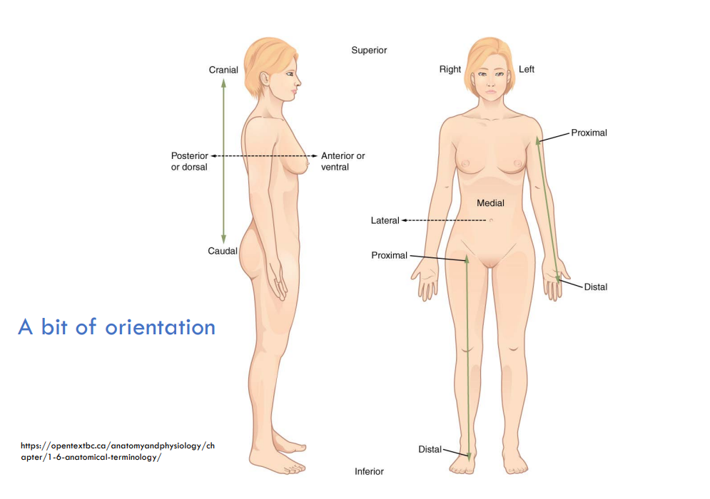
Orient yourself
What is the term for?
Towards the centre of your body?
Towards the sides of your body?
Towards the top of your body?
Towards the bottom of your body?
CLOSER towards the centre of your body
FURTHER from the centre of your body
The front of your body
The back of your body
Towards the top
Towards the bottom

Slide 13
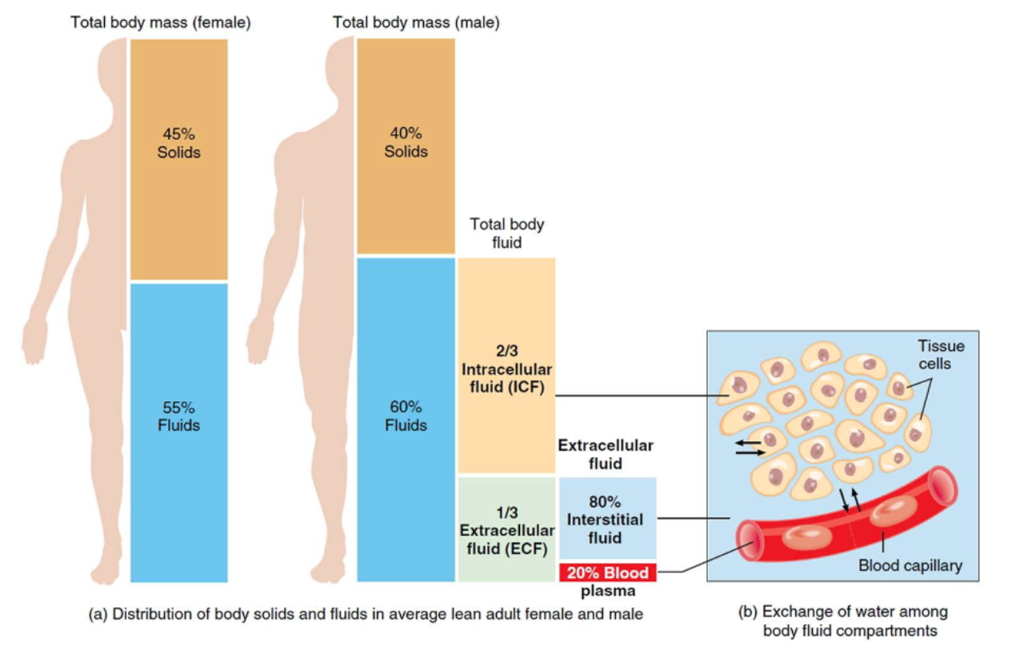
Lecture 1 – Fluid distribution
Describe how much of our mass (as humans) is fluid, how much is intracellular and how much is extracellular
WHERE is this ‘extracellular space’
Ok but where is it really?
What is the difference between extracellular and intracellular fluid?
Remember: The cell floats inside a sea

Slide 14
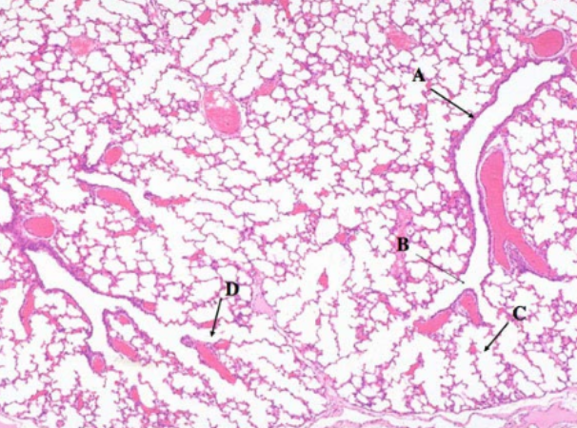
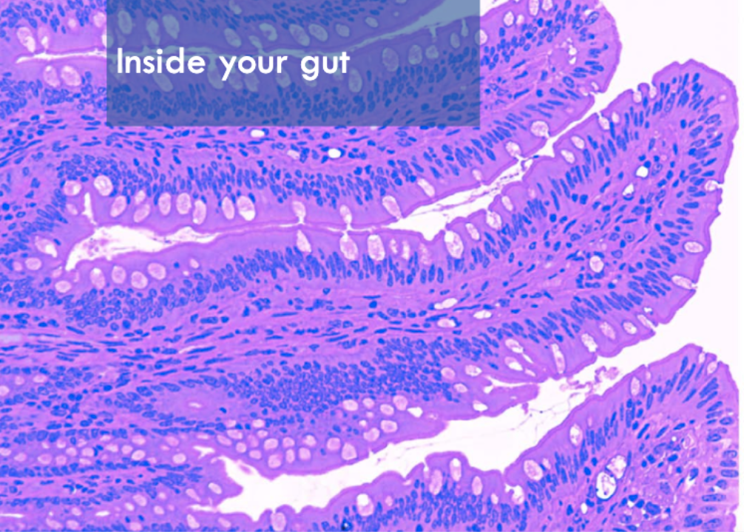
Lecture 1 – High surface area ratios
What structure in the lung is responsible for the massive surface area allowing for diffusion of O2 into and CO2 out of the blood?
What is the structure in the gastrointestinal tract (mainly in small intestine) which allows for absorption of nutrients from digested food?
What is the structure made up of cells
What is the structure incorporated in the cell?

Slide 15
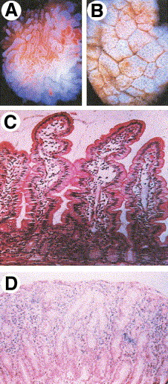
Clinical correlation – Coeliac disease
https://www.gastrojournal.org/article/S0016-5085(05)00177-0/fulltext
Coeliac disease is an intolerance towards glutin-based compounds in food. On consumption, the gastrointestinal tract of a patient with Coeliac’s will undergo total villous atrophy. On microscopy, you will see a loss of villi (diagnostic).
Explain why a patient with coeliac’s disease is at risk of experiencing malnutrition.
Figure 1Small intestinal mucosal biopsy. Small intestinal mucosal biopsy viewed through a dissecting microscope (A and B). The normal biopsy (A) shows numerous surface villi, whereas a biopsy from an individual with celiac disease and total villous atrophy shows, in place of the villi, numerous surface openings to underlying crypts and surface ridges (B). (C) H&E-stained section of a normal small intestinal mucosal biopsy. Features include a crypt to villous ratio of approximately 4–5:1, columnar villous epithelial cells with basally oriented nuclei, a normal complement of intraepithelial lymphocytes (approximately 1 per 6–10 enterocytes) and a normal representation of lymphocytes and plasma cells in the lamina propria characteristic of the “physiologic” inflammation in normal small intestinal mucosa. (D) A small intestinal mucosal biopsy from an individual with celiac disease and total villous atrophy. Note the abnormal surface epithelial cells that are flattened rather than columnar, the complete loss of villi, marked lenghtening of the crypt compartment, the increase in intraepithelial lymphocytes, lymphocytes, and plasma cells in the lamina propria, and increased crypt miltoses.

